Slide 1
Radical Open Access
ACSI 2019
Janneke Adema
Coventry University

Slide 2
Repositioning Open Access
Critiques of the Status Quo/Reimagining Scholarship
Experimentation
New and underserved cultures of knowledge
Ethics of Care

Slide 3
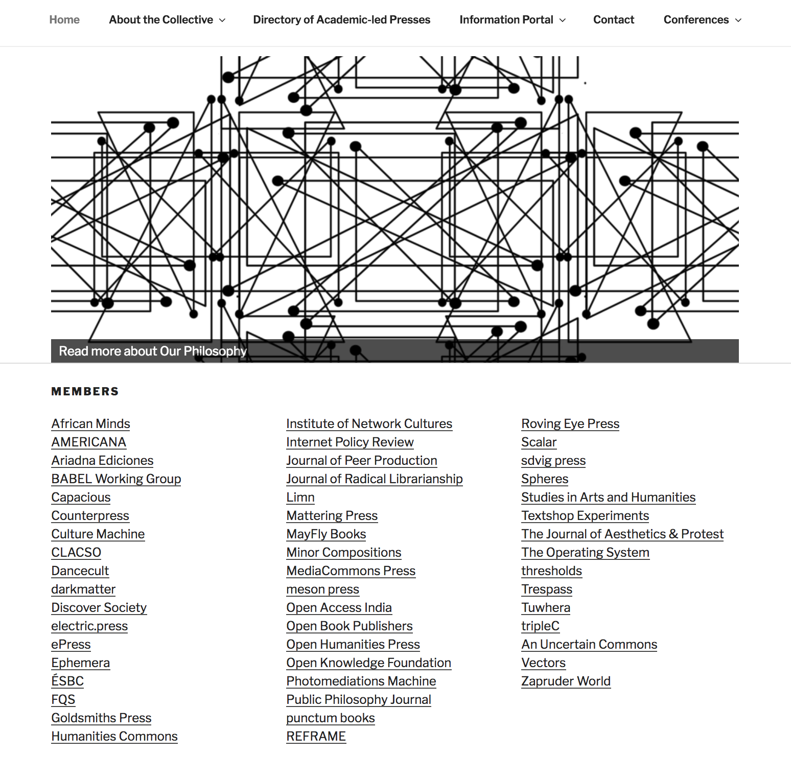

Slide 5
Scaling Small
Scaling through horizontal and vertical collaborations
Working to capacity: 50 books (punctum), 30 (LSP/OBP), 5 (OHP/Mattering)
Transparency and openness about funding models and costs
Bringing down BPCs or fee-waivers
Open source software, platforms and tools
Resources and skills sharing
Experimenting with a variety of different models:
communal editing/publishing: Language Science Press and OHP
Crowd-sourcing/donations/consortia

Slide 7
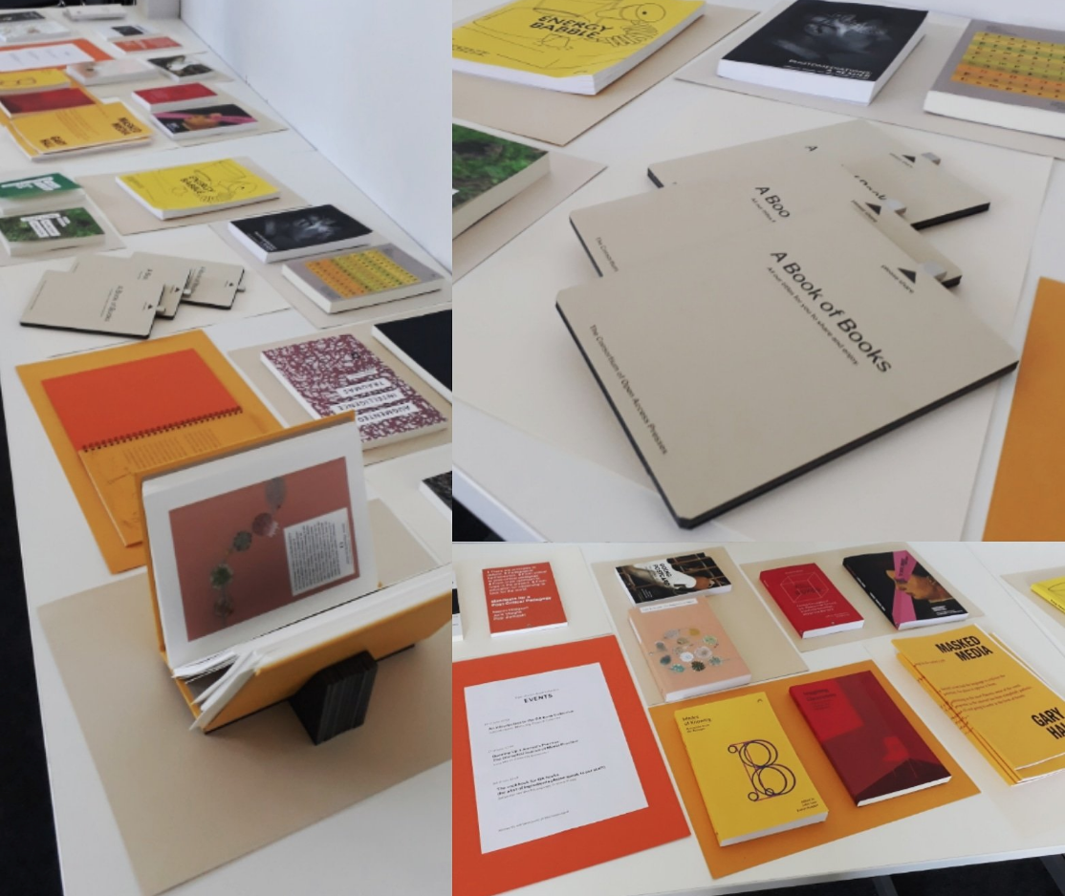
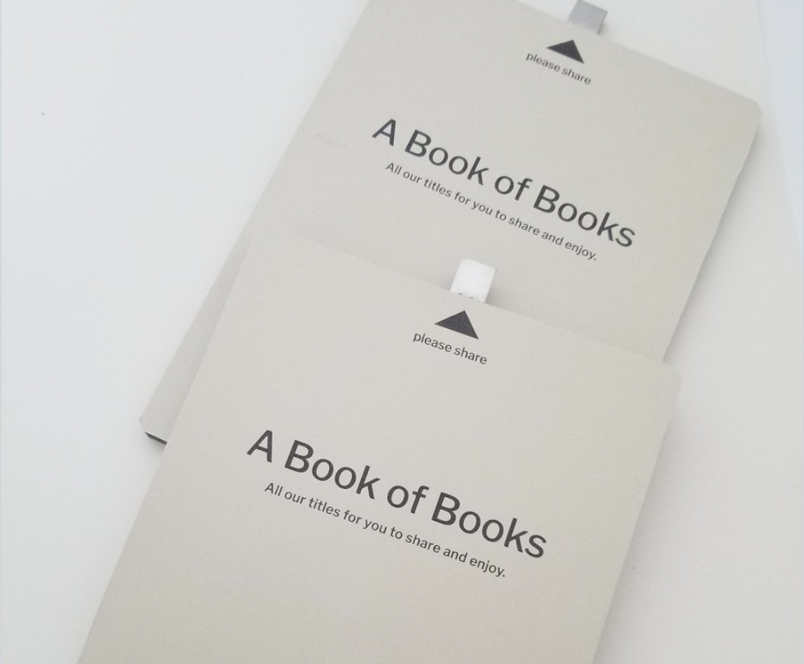
Dissemination and Discovery of OA Books
Library Integration
Collective Conference Presence and Book Stand
Archiving Multimodal OA Monographs

Slide 8
ademaj@uni.coventry.ac.uk
@Openreflections
Radicaloa.co.uk
@RadicalOA
Scholarled.org
@ScholarLed

