Slide 1

Experimenting with Academic Knowledge Production
ROUNDTABLE
with the Open Book Futures Experimental Publishing Group:
Janneke Adema (Coventry University)
Simon Bowie (Coventry University)
Rebekka Kiesewetter (Coventry University)
Julien McHardy (Coventry University)

Slide 2
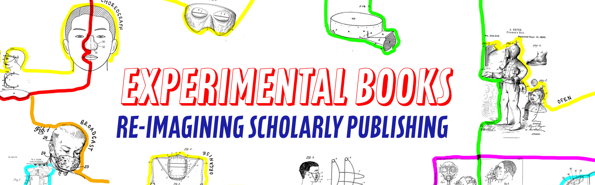

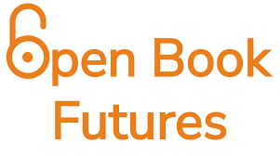


A community working to build a fairer, more open future for scholarly books: https://copim.pubpub.org/
The OBF project will significantly expand key infrastructures created by COPIM to
achieve a step change in how community-owned OA book publishing is delivered.
https://copim.pubpub.org/open-book-futures-project
a guide and reference which brings together tools, practices, and books to promote
the publication of experimental scholarly works. https://compendium.copim.ac.uk/
Our funders:

Slide 3

Dr Janneke Adema (she/her) is a cultural and media theorist working in the fields of (book) publishing and digital culture. She is an Associate Professor in Digital Media at The Centre for Postdigital Cultures (Coventry University) where she convenes the post-publishing research strand. In her research she explores the future of scholarly communications and experimental forms of knowledge production, where her work incorporates processual and performative publishing, radical open access, post-publishing, scholarly poethics, media studies, book history, cultural studies, and critical theory. She explores these issues in depth in her various publications, but also by supporting a variety of scholar-led, not-for-profit publishing projects, including the Radical Open Access Collective, Open Humanities Press, and Post Office Press (POP), the Copim community, and the Research England and Arcadia funded Open Book Futures project. Her monograph Living Books. Experiments in the Posthumanities (MIT Press, 2021) is openly available. She is also a co-editor (together with Dr Alyssa Arbuckle) of the Journal of Electronic Publishing. You can follow her research on https://www.openreflections.org/

Slide 4
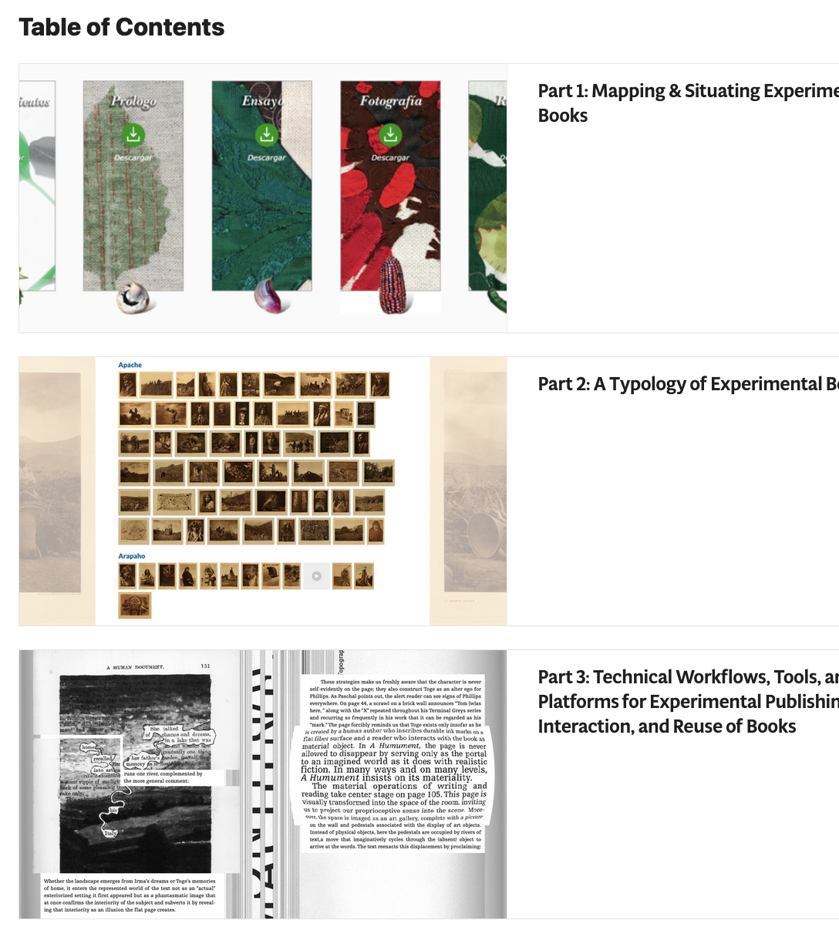
Adema, J., Bowie, S., Mars, M., and T. Steiner (2022) Books Contain Multitudes: Exploring Experimental Publishing (Version 2.0). Community-Led Open Publication Infrastructures for Monographs (COPIM). doi: 10.21428/785a6451.1792b84f
https://copim.pubpub.org/books-contain-multitudes-exploring-experimental-publishing-2022-update

Slide 5
different kinds of experiments
Experiments with the form and format of the scholarly book;
Experiments with the various (multi)media through which books can be performed;
Experiments with the ways in which scholarship can be produced, disseminated, and consumed;
Experiments that reimagine the relationalities that constitute academic writing, research, and publishing.

Slide 6
situating experimental publishing
Codex
Digital
Openness

Slide 7
experimental publishing observations
Content and form are entangled
Reimagining roles and relationalities
Collaboration and interaction
Care and Stewardship

Slide 8

Pilot Project
Deep Maps: Blue Humanities
James Louis Smith
Jenny Evans & Richard Baggaley
University of Westminster Press
Jessica Pokharel & Alex Humphreys
JSTOR Labs | JSTOR | ITHAKA
Simon Bowie & Julien McHardy
OBF Experimental Publishing Group

Slide 9
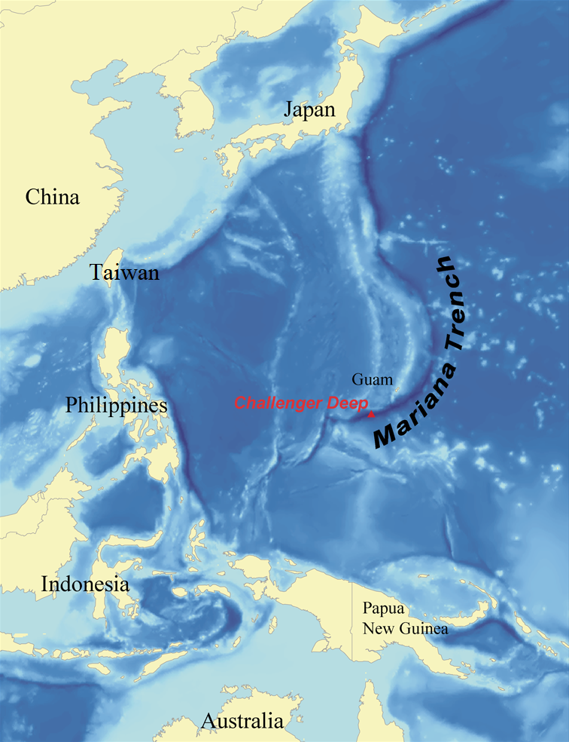
...the book travels deep into the ocean as the argument unfolds
...
to the Challenger Deep, the deepest known point of the seabed of Earth

Slide 10
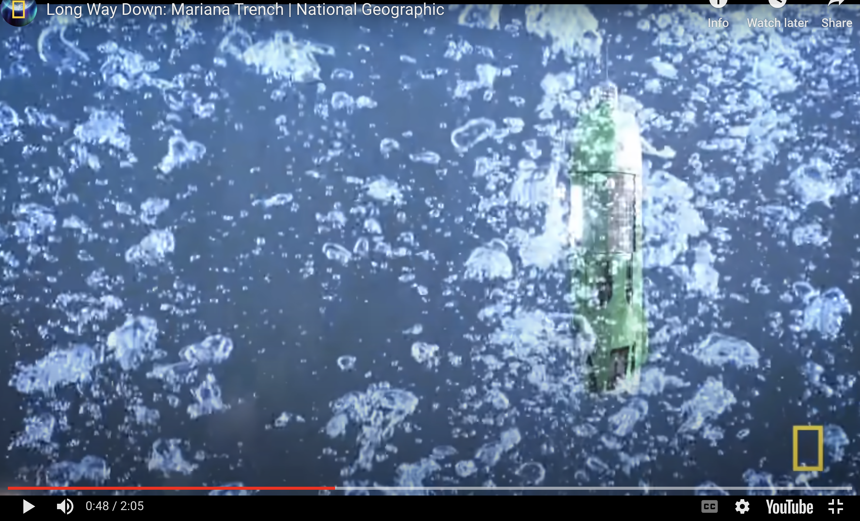
https://youtu.be/Y2tm40uMhDI?t=46

Slide 11
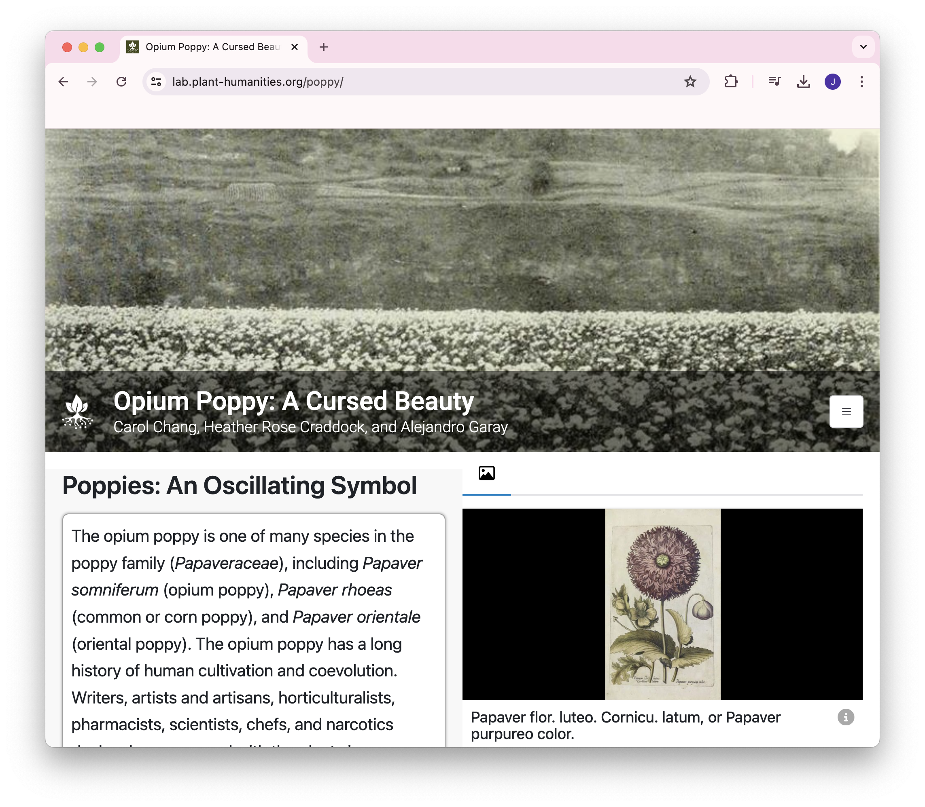
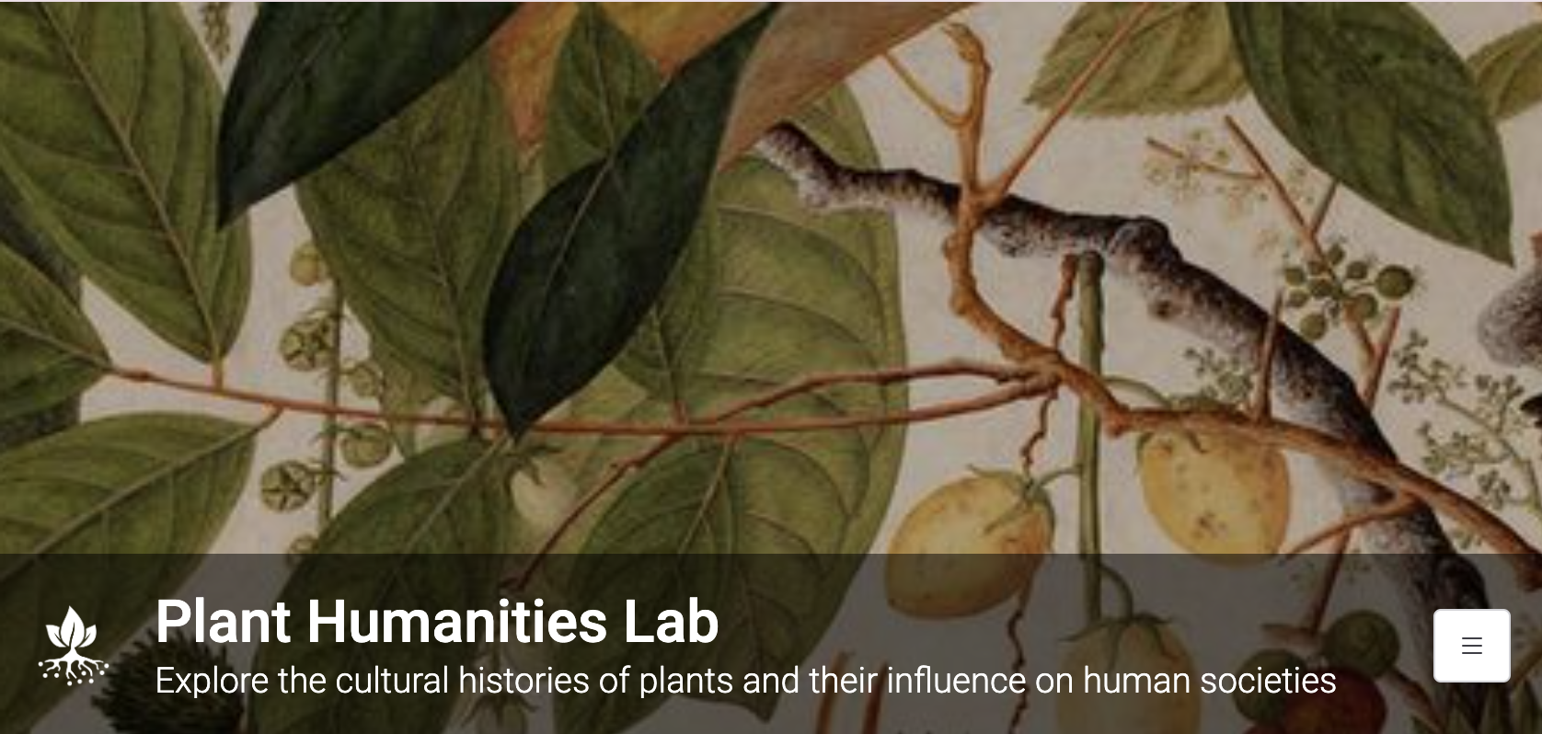
Juncture
Showcase: Plant Humanities Lab
https://lab.plant-humanities.org/poppy/

Slide 12

The project builds on Juncture’s Markdown-based visual essaying methods and the author’s
experimental writing and publication process to create a responsive design
design that changes
as the book
dives
deeper.

Slide 13
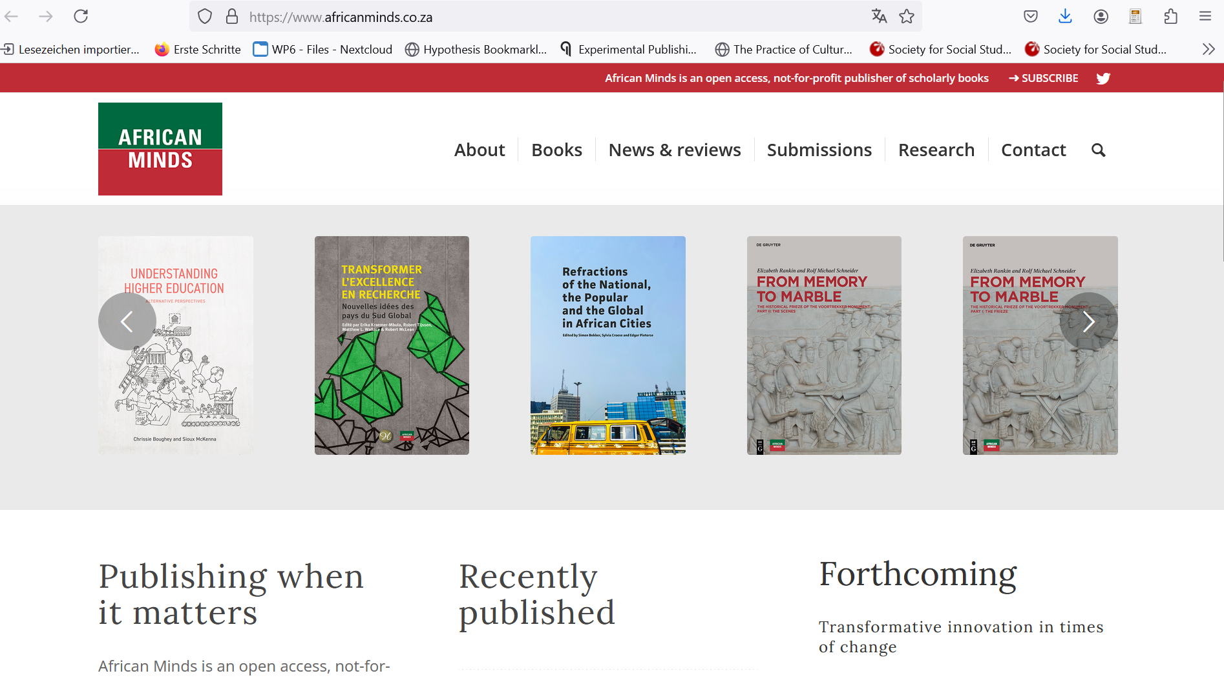
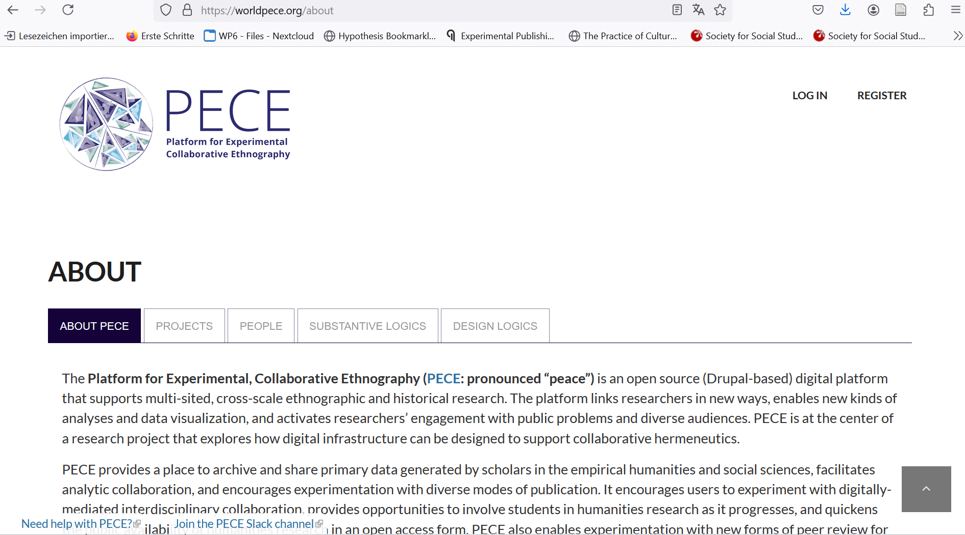
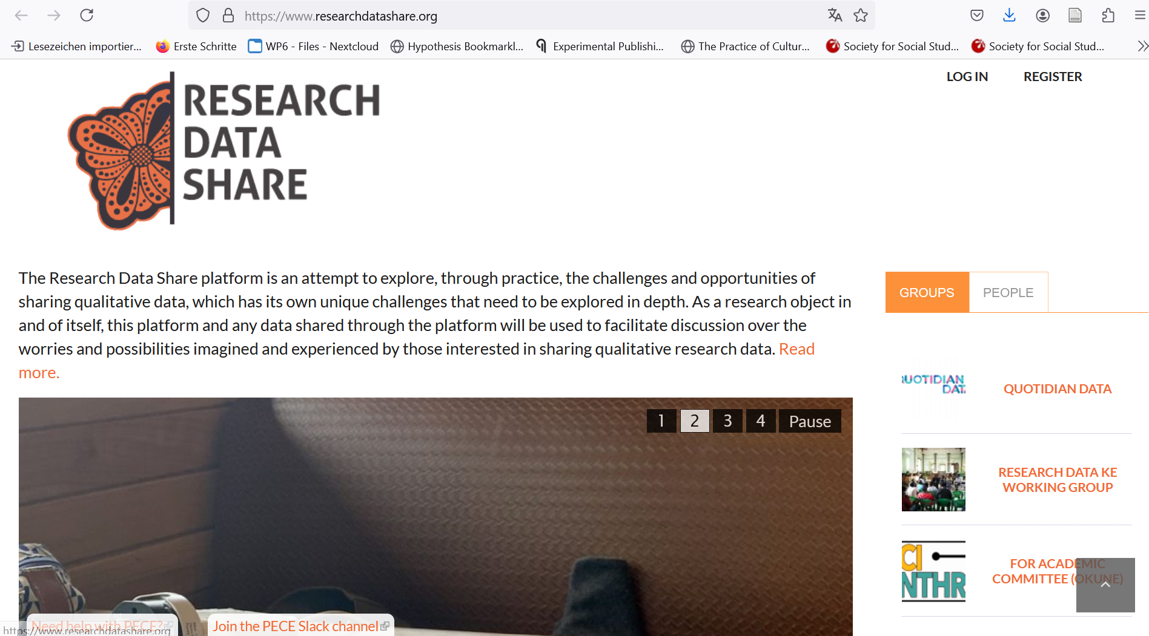
Database as Book and Lively Community Archive
Research Data Share Collective;
African Minds;
Platform for Experimental Collaborative Ethnography (PECE)

Slide 14
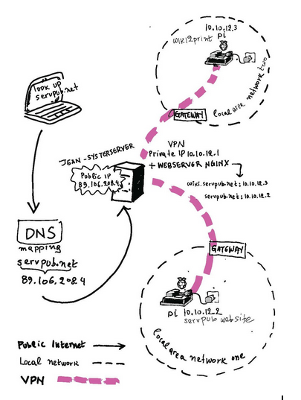
Servpub – A Collective Infrastructure to Serve and Publish
Slade School of Fine Art, part of the University College London;
CSNI, a research centre at London South Bank University;
SHAPE, a research project at Aarhus University focused on digital citizenship;
Minor Compositions, a publisher of books and media drawing from autonomous politics, avantgarde aesthetics, and the revolutions of everyday life;
In-grid, a London-based trans*feminist collective of artists/educators/technologists working in and around digital infrastructure;
Syster Server, an international collective run by feminists that offers internet-based FOSS tools to its network of feminists, queers and trans;
Creative Crowds, a shared server for FLOSS publishing experiments to explore how different ways of working are shaped by (and shape) different realities.
Image: Mara Karagianni

Slide 15
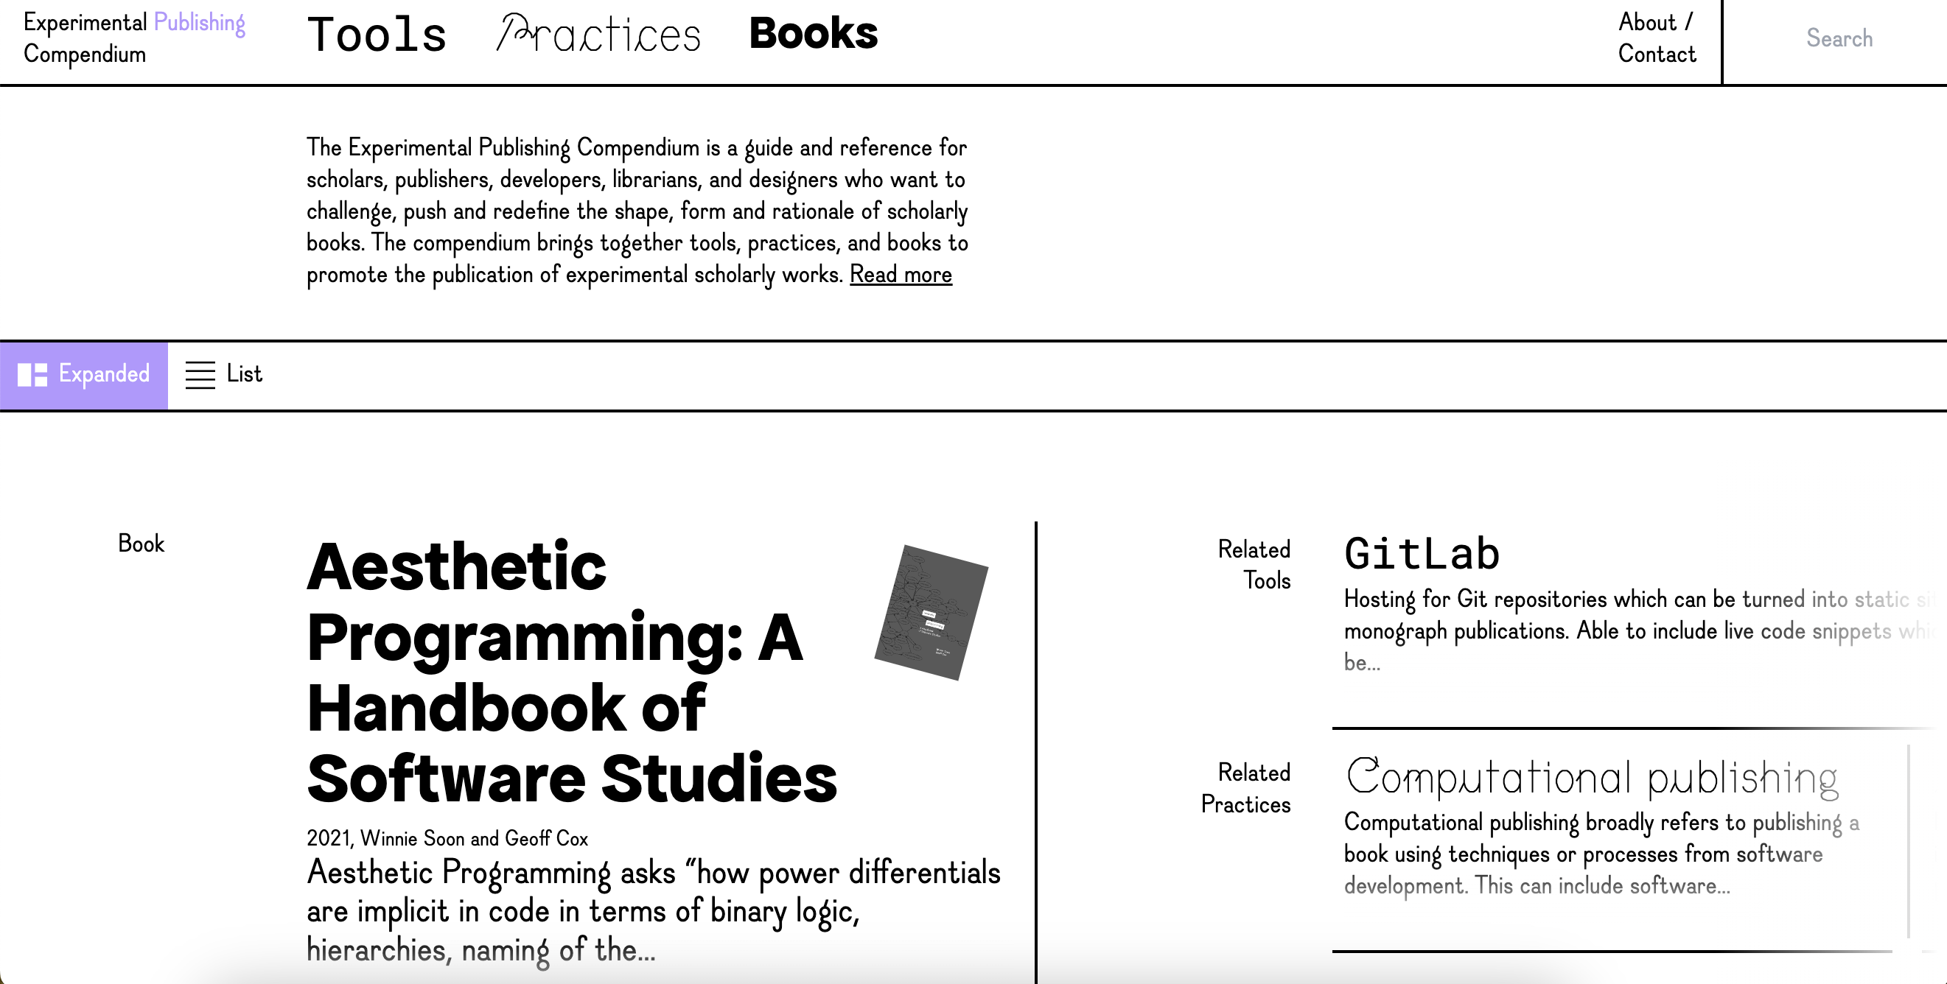
https://compendium.copim.ac.uk

Slide 16
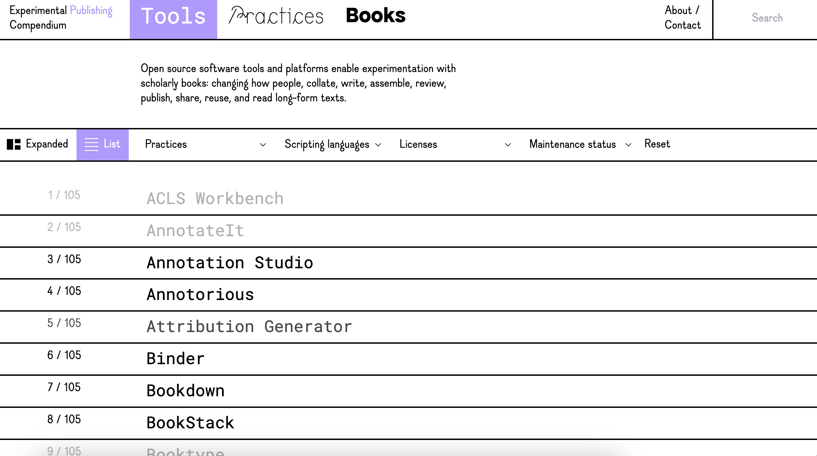

Slide 17
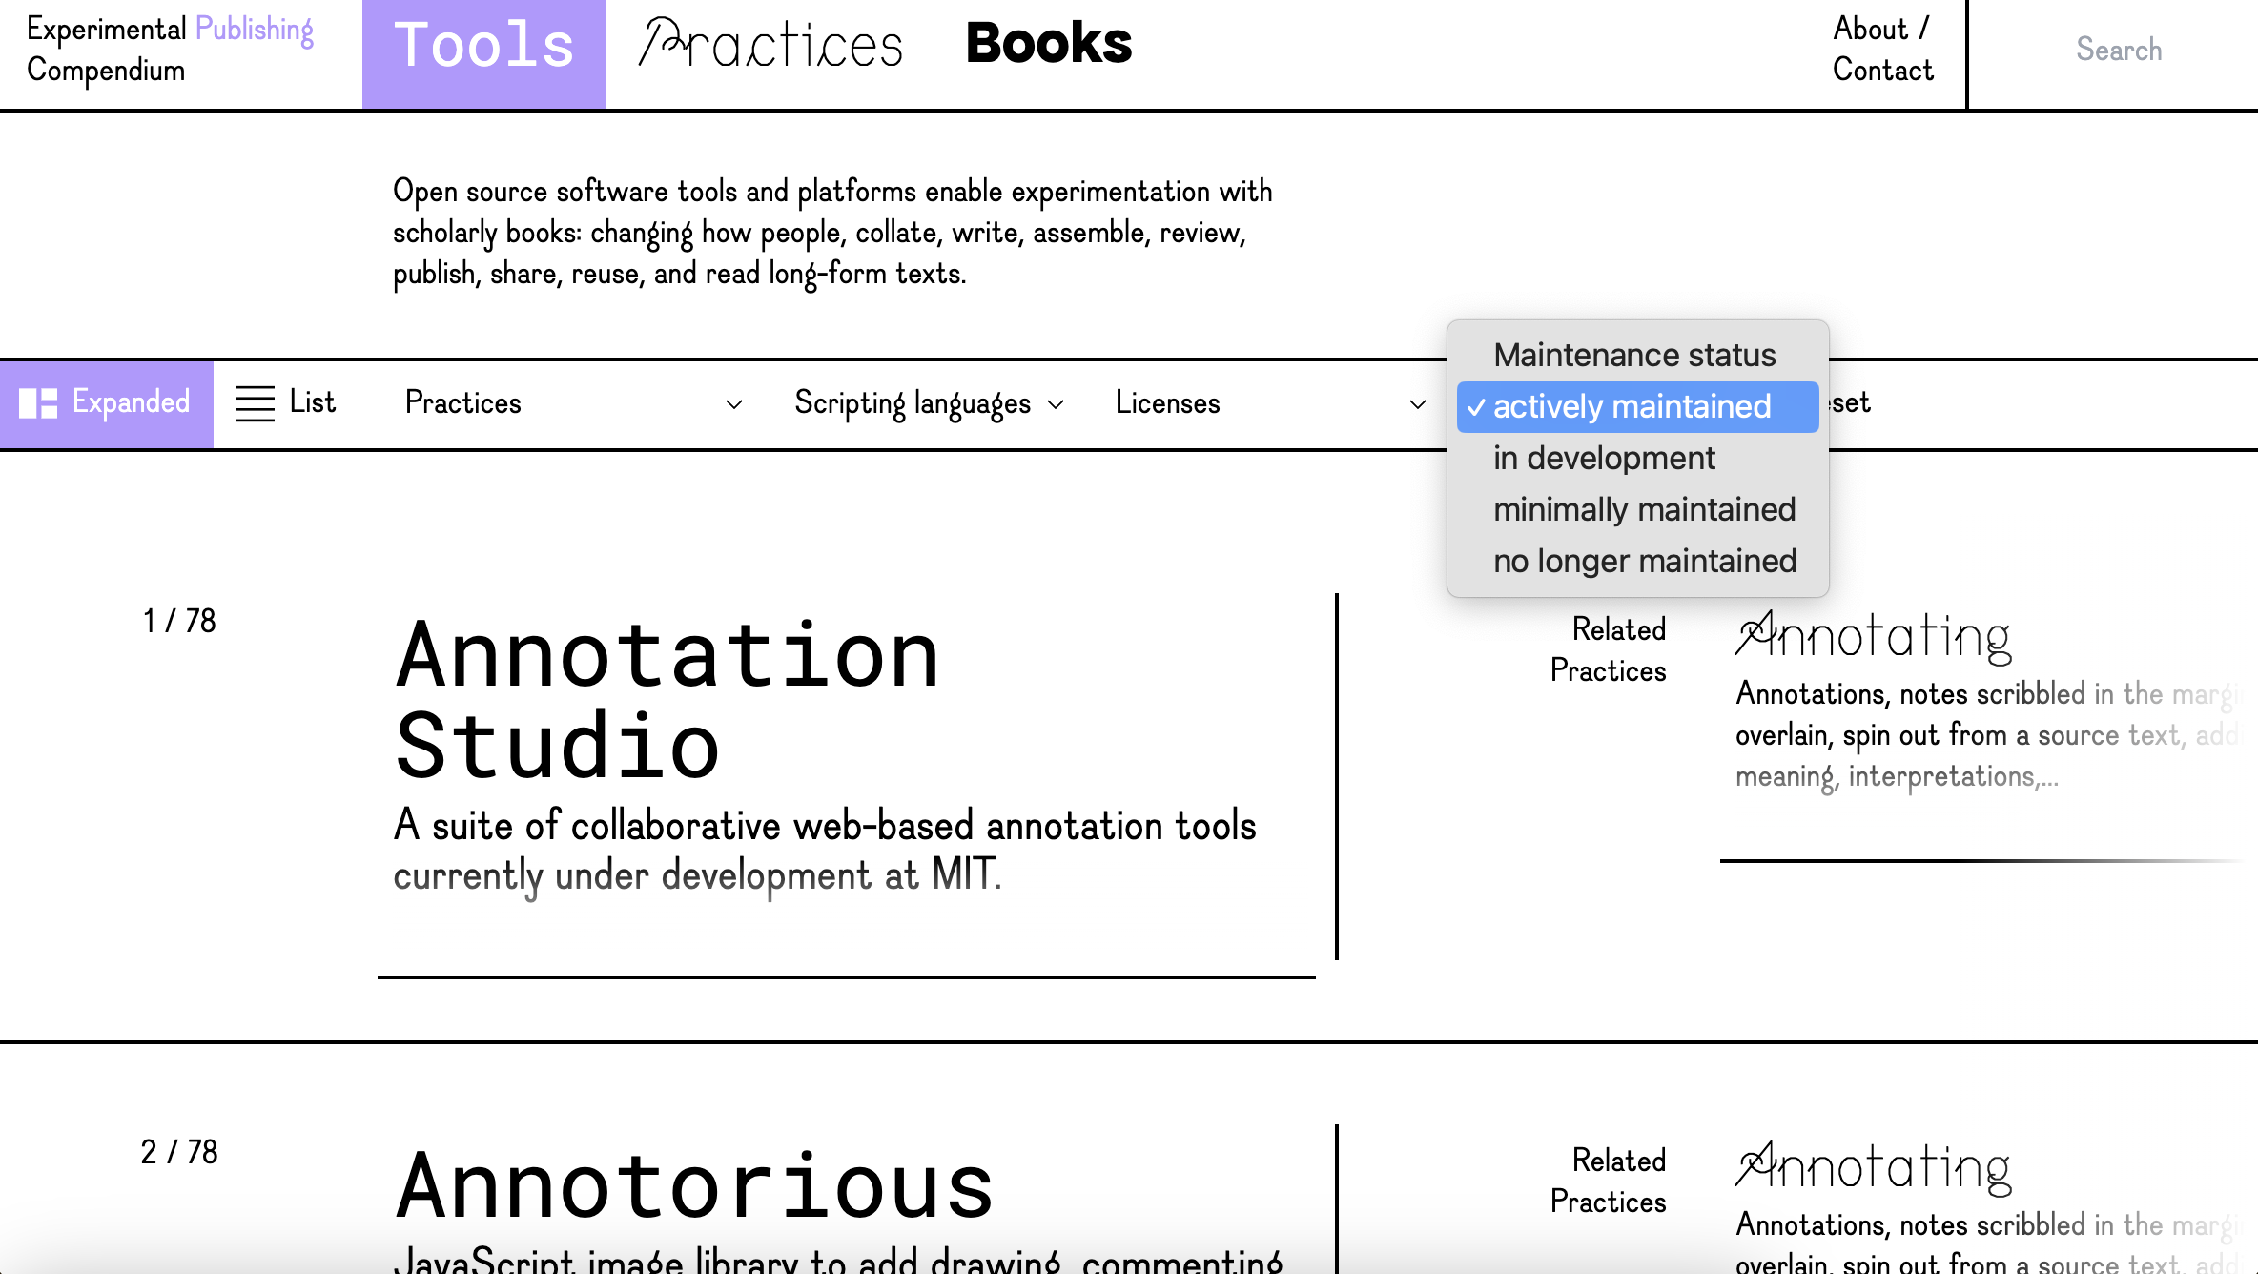

Slide 18
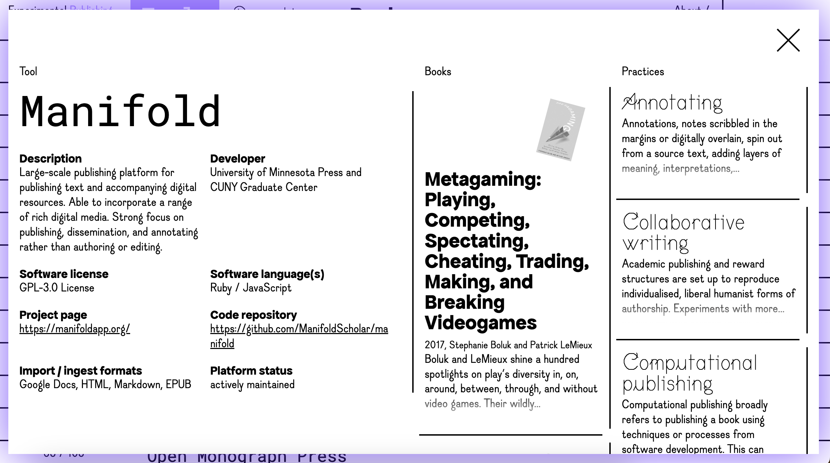

Slide 19
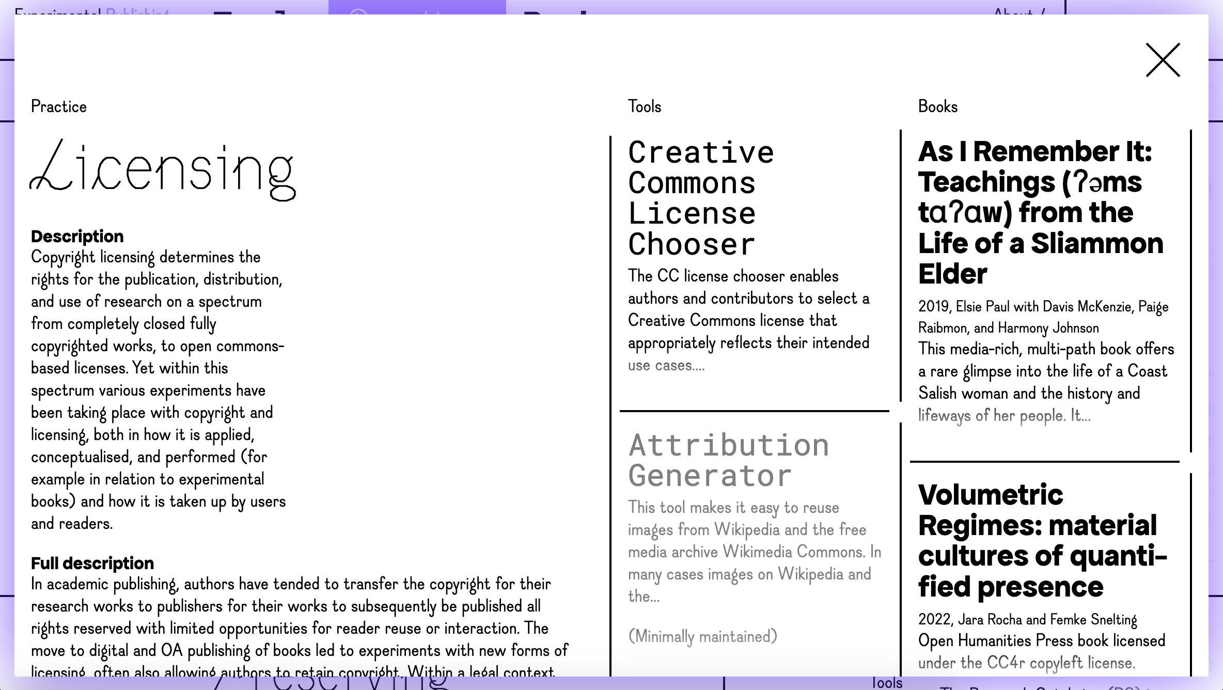

Slide 20
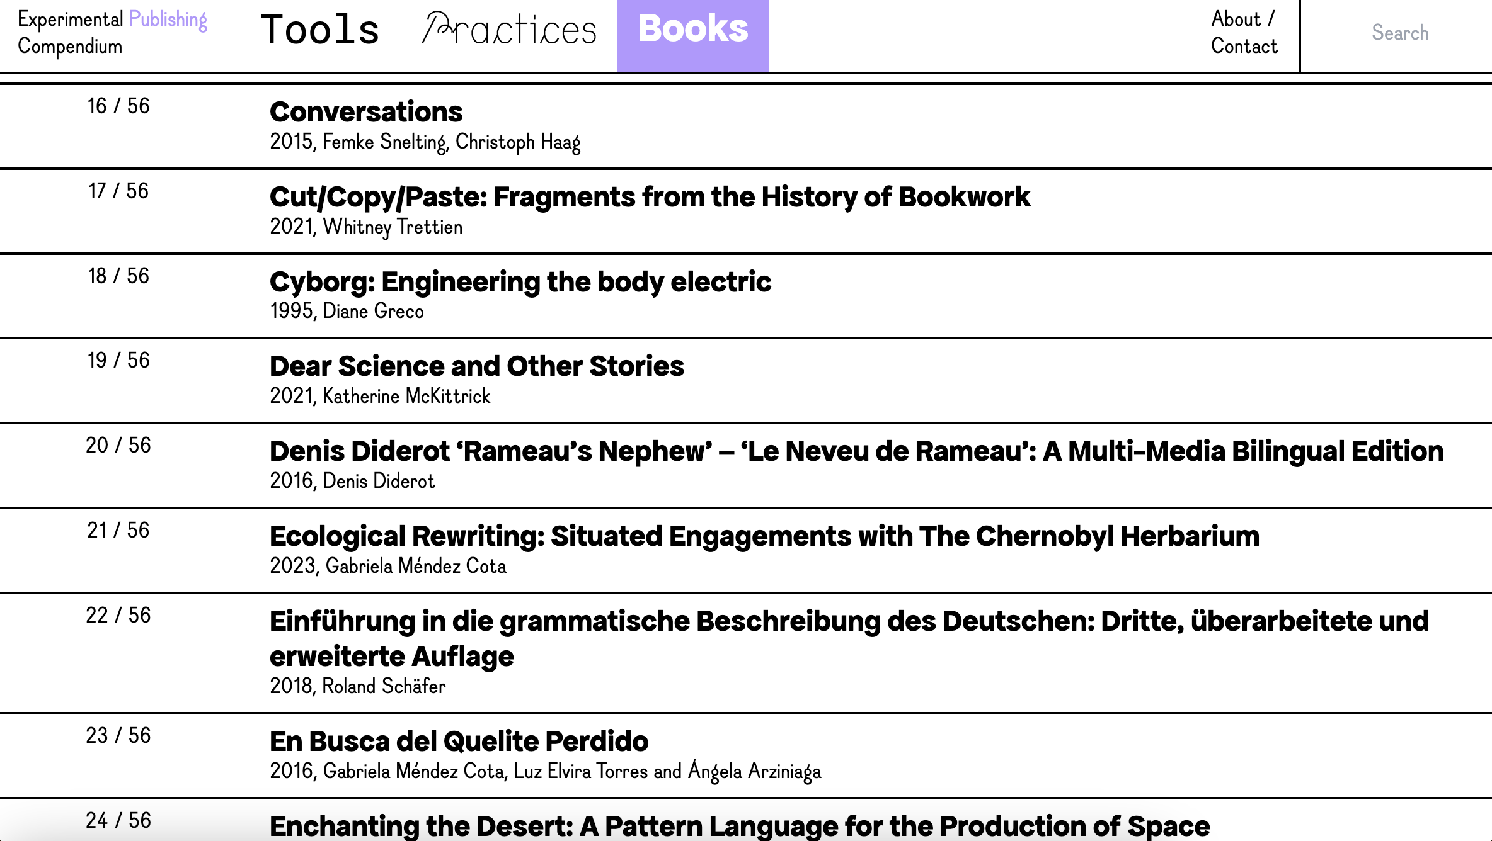

Slide 21
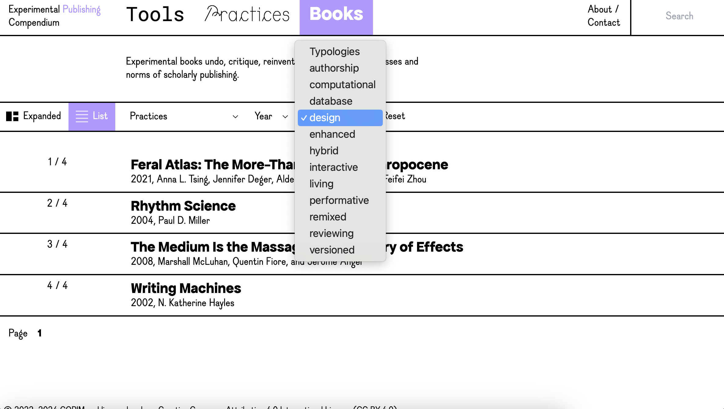

Slide 22
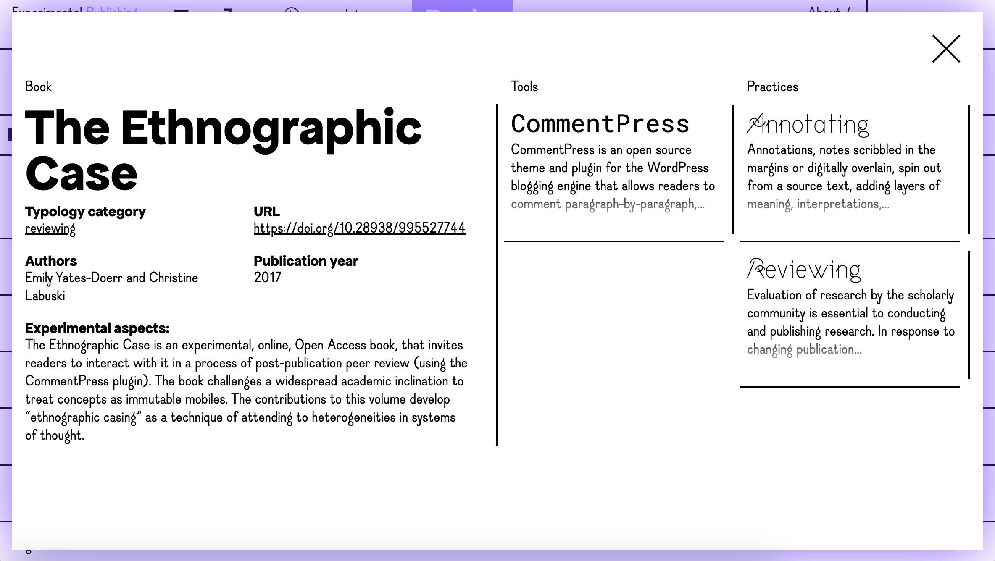

Slide 23
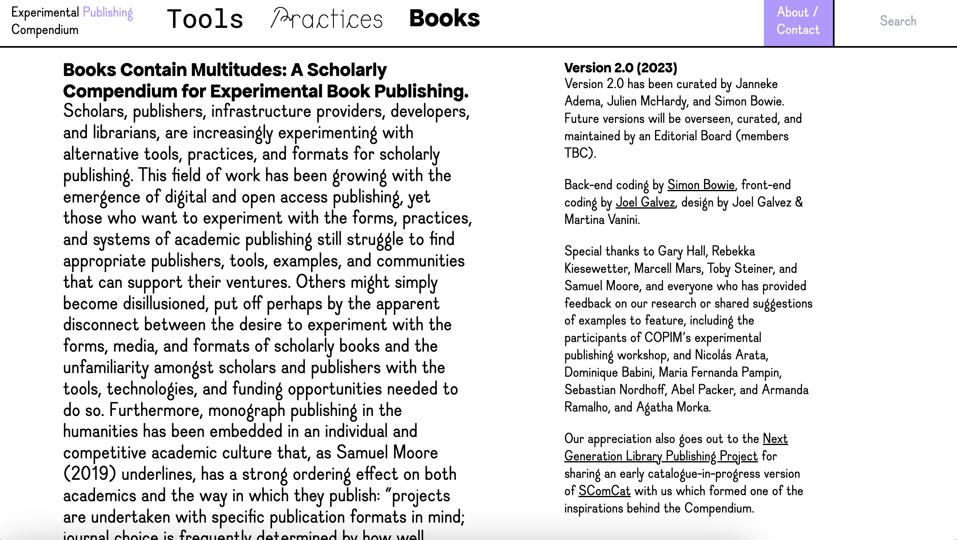

Slide 24
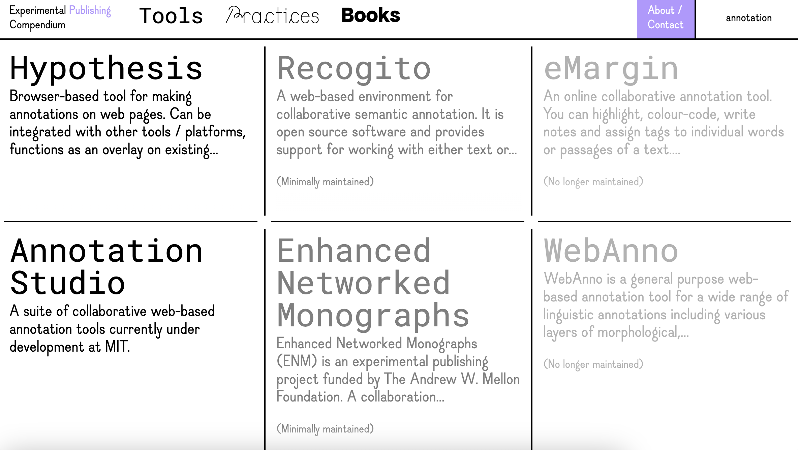

Slide 25
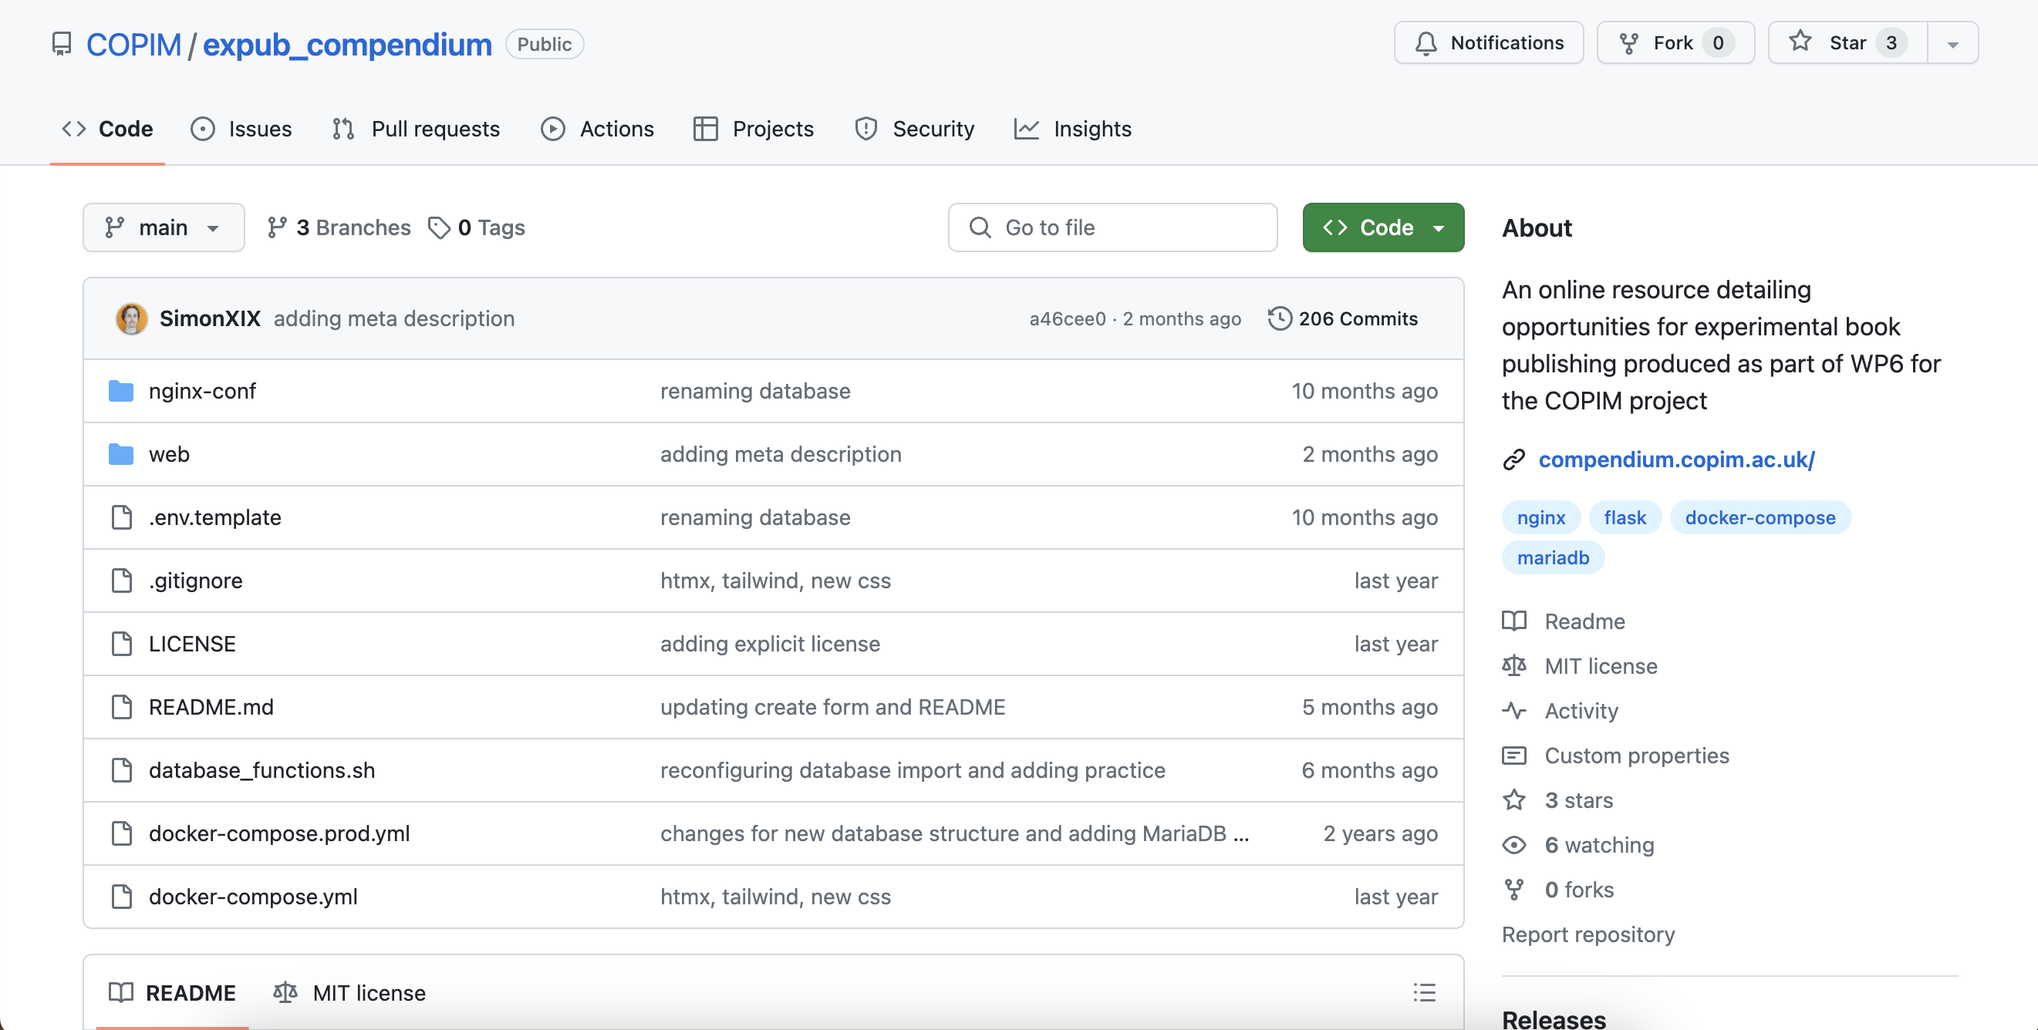
https://github.com/COPIM/expub_compendium

Slide 26
Many experimental publishing projects focus on increasing interaction around books and texts. What are some of the important lessons learned from earlier experiments that relate to this or from our own experiences as scholars and publishers with social scholarship (e.g. annotations, open peer review, collaborative authorship)?
Inhibitions related to experimental publishing are often related to lack of time, funding, and expertise. Could we share some examples of how people have started to address these?
How can publishers communicate better whether they are open for more experimental forms of book publication and if so how can they communicate better what types of publications they can support?
Experimental book publishing projects have seen most uptake in those fields and amongst those scholars who are technologically savvy (e.g. the Digital Humanities). How can we support and or start to interest those that are less tech savvy in the possibilities that experimental publishing offers?
Experimental publishing projects can be seen to provide new imaginaries for the future of book publishing, yet at the same time they have often been initiated as a critique of the fixed and stable codex book, the single proprietary author, and existing copyright and metrics systems. Are alternative imaginaries enough to enact change or should we first and foremost focus on tackling these humanist and neoliberal publishing legacies?

